Slide 1

















DEPARTMENT OF ELECTRICAL AND ELECTRONICS ENGINEERING
18EEP302L – MINOR PROJECT IV
Second Review Batch - 01
TOPIC: SMART SHOPPING CART WITH AUTOMATBILLING SYSTEM
PRESENTED BY:
GUIDED BY:
ABINAYA P MADHUMITHA D S KARTHIKA P
(20BEE4001) (20BEE4044) (20BEE4027)
Mr. M RAMESH,
Assistant Professor/EEE,
M Kumarasamy College Of Engineering, Karur.
22-04-2023
18EEP302-Minor Project IV
1

Slide 2


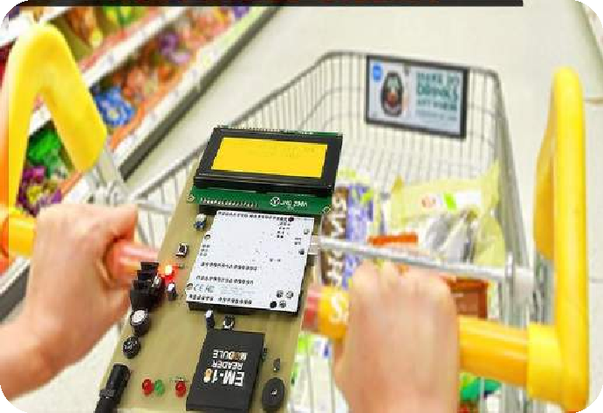
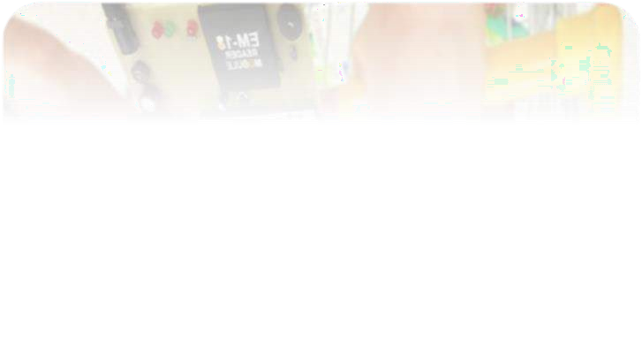
Overview of Presentation
Abstract
Introduction
Literature survey
Existing Block Diagram
Proposed Block Diagram
Circuit Diagram
Components and its Specification
Hardware Setup
Conclusion
List of publication
2

Slide 3

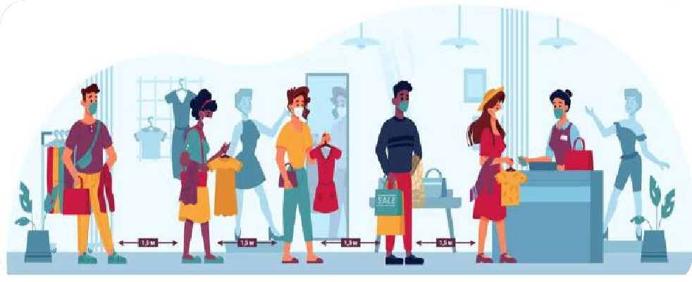

Objective
The main objective of the project is to satisfy the customer and to reduce the time spent on the billing process, which is to complete the billing process in the trolley rather than waiting in a queue for one or two products.
The proposed system will give the customer a quick shopping experience by generating automatic billing to avoid huge crowd or large queues in shopping malls and super markets.
3

Slide 4

Abstract
In this project, we are proposing a new technique for shopping that is smart shopping cart with automatic billing system using RFID technology and Arduino.
The main intention of our project is to gratify the consumers and to minimize the time by doing the billing process in the trolley or cart.
Here, we will design a Shopping Cart with automatic billing system. To design this project we need only a few electronic components, it is an added advantage to this project.
Hence, it makes cost effective than other methods of technologies.
4

Slide 5

Abstract cont..,
To achieve this billing every product in Shopping centre should have the RFID tag,
and every trolley will have the EM 18 RFID Reader to scan the object.
When the object is scanned, then the object name and price will be automatically sent and display in the LCD Display.
The LCD Display will also display the total amount of the purchased items. Thus, the consumer can easily pay the total bill without waiting in the queue for long period.
Keywords: Smart Shopping Cart, RFID Technology, Automatic Billing System,
EM 18 RFID Reader
5

Slide 6

Introduction
The modern technology has increased the standard of living for the humans.
A supermarket is a place where customers come to purchase their daily using products and pay for them. So there is a need to calculate how many products are sold and generate the bill for the customer.
When we go to a shopping cart for shopping, we have to seek for selecting the right product. Also, after that, it is hectic to stand in line for billing all the products. Hence, we are proposing to develop a smart shopping cart system that will keep the track of purchased products for billing using RFID and Arduino.
6

Slide 7

Literature Survey
S.NO | TITLE | AUTHOR | YEAR | DESCRIPTION
01. | SMART SHOPPING CART USING RFID TECHNOLOGY | Mrs.K.Latha Sandhya U , Gayathri L, Vijayarani V, Mr.Santhosh kumar S | May 2019 | This paper presents about the proposed system, that will give the customer a quick shopping experience by providing the product details on the customer’s smartphone using machine learning algorithms, and will display total bill amount on the display screen attached to the cart using RFID technology. RFID is used to identify each product details not only by its type but also knowing its location. This will make sure to the customer whether their shopping is under budget or not.
02. | IMPLEMENTATIO N OF SMART SHOPPING CART USING RFID | Nilesh Unde, Shankar Shinde, Abhishek Thombare, Satish Suryawanshi, Harshada Mhaske | Nov 2015 | The system provides centralized and automated billing system that uses RFID and Bluetooth communication modules. Each product of shopping mall will have a RFID tag . Each shopping cart will be designed with a Product Identification Device (PID). Information of the product that is to be purchased will be read through a RFID reader on shopping cart, in the mean while that product’s information will be stored into EEPROM which will be attached to the cart and that data will be send to Central Billing System through the Bluetooth module. When the central billing system receives the cart information and data stored in EEPROM, then the system will access the product database and calculates the total amount to be paid for that particular cart. Main aim of the project is to generate automatic billing to avoid huge crowd or large queues in shopping malls and super markets.
21-04-2023
18EEP302L-Minor Project IV
7

Slide 8
Literature Survey
S.NO | TITLE | AUTHOR | YEAR | DESCRIPTION
03. | RFID BASED | Mhamunkar, | 2019 | This paper says presents, people buy a different product and deposit them in the
 | SMART | Himanshu |  | trolley. After total purchase one need to go to billing counter for the payment which
 | TROLLEY | Saroj,Prajakta |  | is very time consuming and at times very frustrating. So their main objective for
 |  | Katkar,Akansh |  | designing this prototype is to reduce the human efforts, eliminate the queue and also
 |  | a Tiwari, |  | eliminate the time taken during billing. Our prototype consist of components such as
 |  | Rahul Jena |  | RFID tags which is used for identification of the product, RFID reader which is used
 |  |  |  | for scanning of product when put in the trolley and it display in the LCD Display. So
 |  |  |  | at the billing counter the data is sent into the server.
04. | SMART SHOPPING CART USING RFID | Vaidhyanathan RM ,Venkata Krishnan, Pradeep RajG, Hemamalini S | 04 Apr 2021 | This paper targeted to minimize the Queue at a billing counter in a shopping mall. The customer can directly pay the amount either in-app or in the billing counter and leave with the commodities he/she has bought. The hardware relies on Arduino Uno, RFID Reader Module, RFID Card, and Buzzer. It eliminates the normal scanning of products at the counter and in turn speeds up the entire process of shopping is easy and also with this system, the customer shall know the total amount to be paid. Hence the customer can plan his shopping only by buying the essential commodities according to his savings. Since the entire process of billing is based on RFID, so it reduces the possibility of human error substantially. The system also has a feature to delete the scanned products by customers to further optimize the shopping experience.
21-04-2023
18EEP302L-Minor Project IV
8

Slide 9
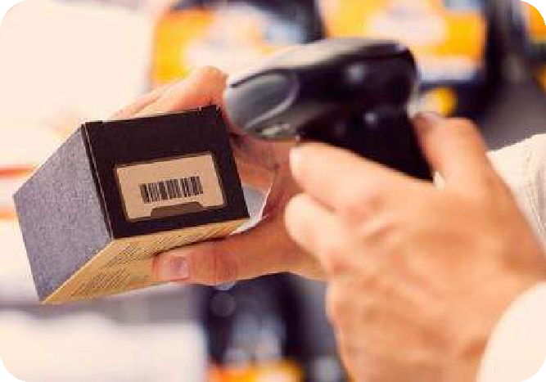

Problems Identified with Existing System
Barcodes are used in retail stores as part of the purchase process but Barcodes do not have read/write capabilities. It requires optical line of sight (LOS) scanning. It is labor intensive as it requires to be scanned individually. It is less secure compare to RFID which can be easily forged. Scratched or crumpled barcodes may cause problems while scanning.
21-04-2023
18EEP302L-Minor Project IV
9

Slide 10
Proposed Block Diagram
LCD DISPLAY
POWER SUPPLY UNIT
USART
[SPI]
ARDUINO UNO
DECREMENT
SWITCH
EM 18 RFID
READER
21-04-2023
10
18EEP302L-Minor Project IV

Slide 11
Proposed Block Diagram Description
Arduino is interfaced with all the remaining components. Once the microcontroller is powered up with the use of a power supply, it is initialized and set to the basic settings, now the system is ready to proceed which means the RFID card and the tag can be scanned.
Then the RFID card or tag is scanned, the RFID reader fetches all the details from the scanned card or tag, and if the scanning process is successful, the product details will be transferred to the microcontroller memory and then it will be transferred to the LCD module for display on the LCD screen.

Slide 12
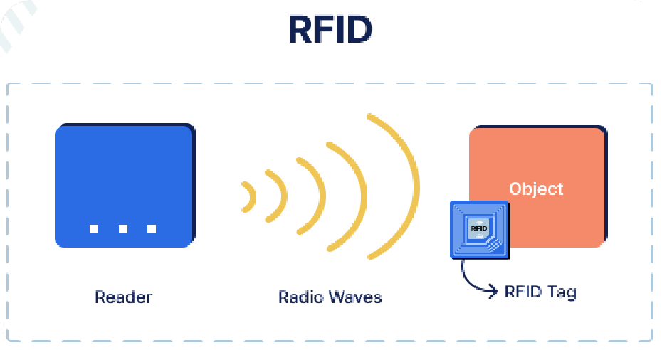
Proposed Block Diagram Description cont..,
Here the RFID module uses the SPI communication technique [USART] to transfer or to retrieve the data from the RFID card or tag . After the shopping is completed the entire bill details will be displayed on the LCD screen, each card or tag acts as a product, where the product details are pre early set or dumped into the card.
The entire working process is implemented by the software called Arduino IDE. We can also check with the Proteus simulation software before the hardware implementations.

Slide 13

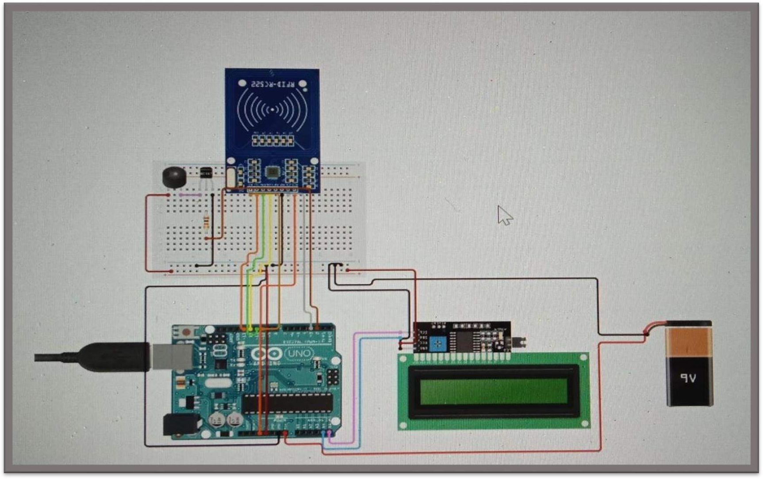
Circuit Diagram
21-04-2023
13

Slide 14
Circuit Diagram Explanation
The power supply is given to microcontroller board (UNO) through rectifying unit and transformer which converts the incoming ac to dc and it is desirable for all components to get initialized for working.
From Arduino UNO, LCD Display (16x2) and the EM-18 RFID Reader Module are connected, the EM-18 Reader will be used to scan the products with RFID cards.
After scanning, the data will be send to microcontroller, then it reaches LCD
Display which will display the price details and the product name.
This is the simple connection of our project which makes easier and simpler to implement in carts of all shopping malls and super markets.

Slide 15
Components and its Specification
Components | Specification | Quantity | Price(₹)
Arduino | UNO | 1 | 800
Transformer with full bridge rectifier | 230V to 12V | 1 | 580
LCD Display | 16x2 LCD I2C | 1 | 250
RFID Reader Module | EM-18 | 1 | 450
RFID Reader cards | Plastic thin card | 3 | 135
Push Button Switch | MAX 50mA 24 DC | 1 | 80
TOTAL =2295

Slide 16
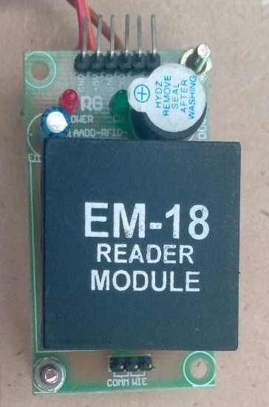
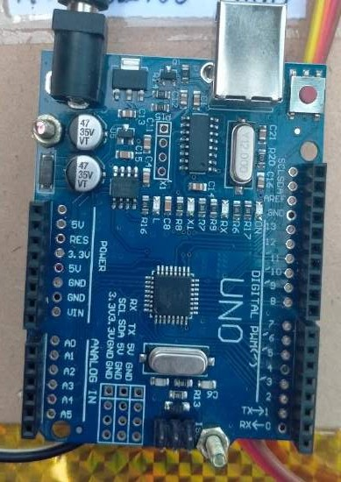
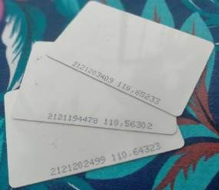
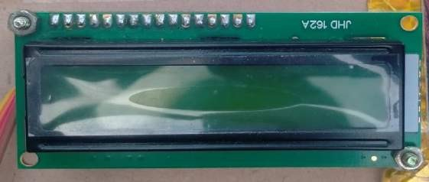
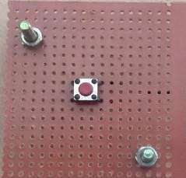
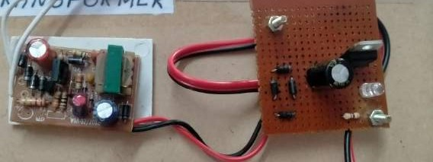
Hardware Components
RFID CARDS
LCD DISPLAY 16x2
EM-18 READER MODULE
ARDUINO UNO
PUSH BUTTON SWITCH
RECTIFYING UNIT WITH TRANSFORMER

Slide 17

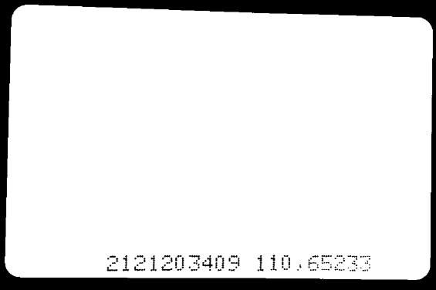
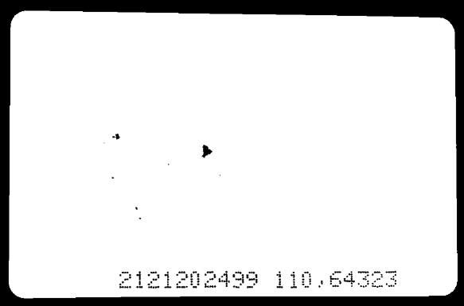
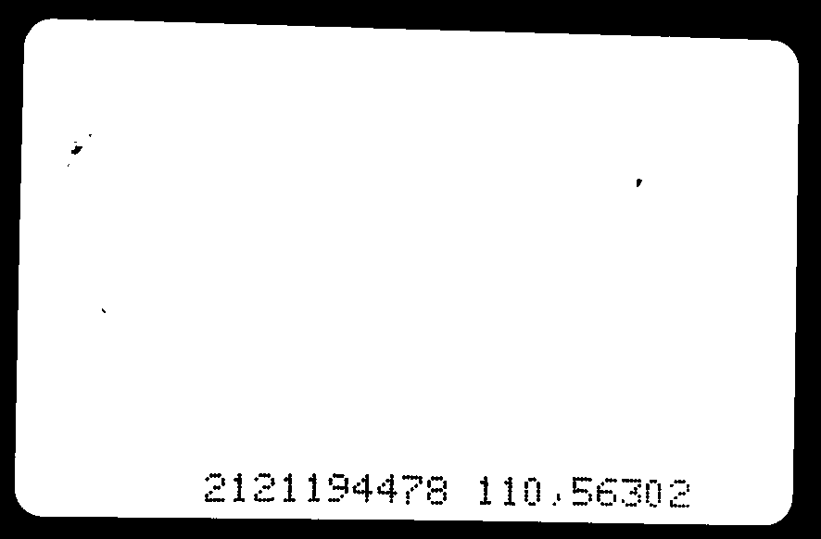
RFID Cards
5 STAR Rs.20
PARLE-G Rs.15
BUTTER Rs.30

Slide 18
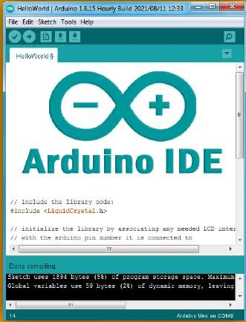
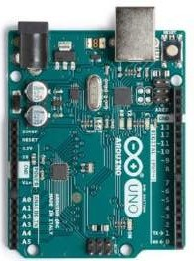
Software Tools Required
Programming Language :Embedded C
Arduino IDE
To upload the program code from Arduino IDE software to Arduino UNO

Slide 19

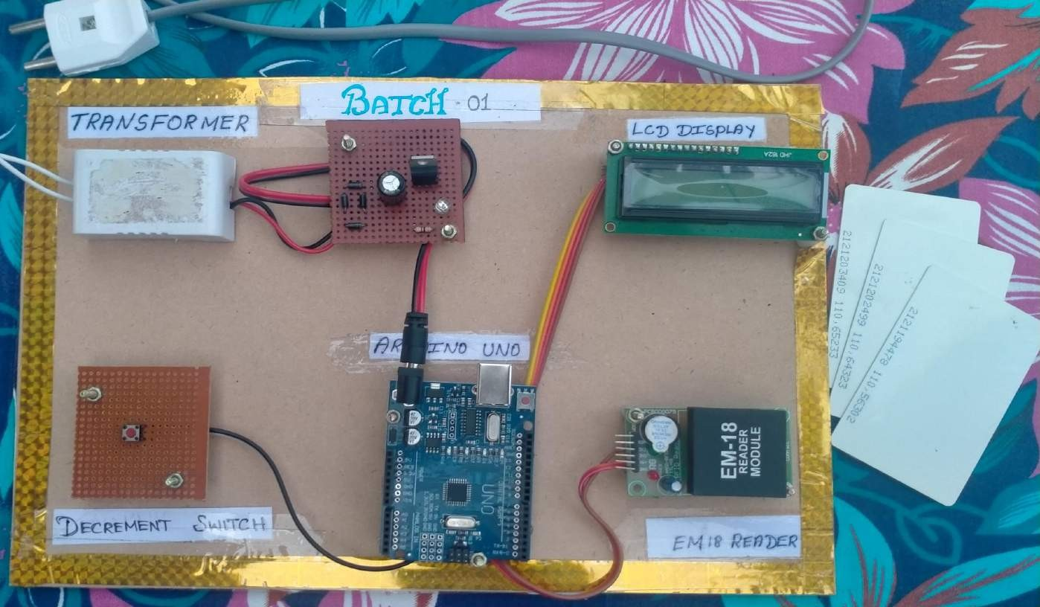
Hardware Setup

Slide 20

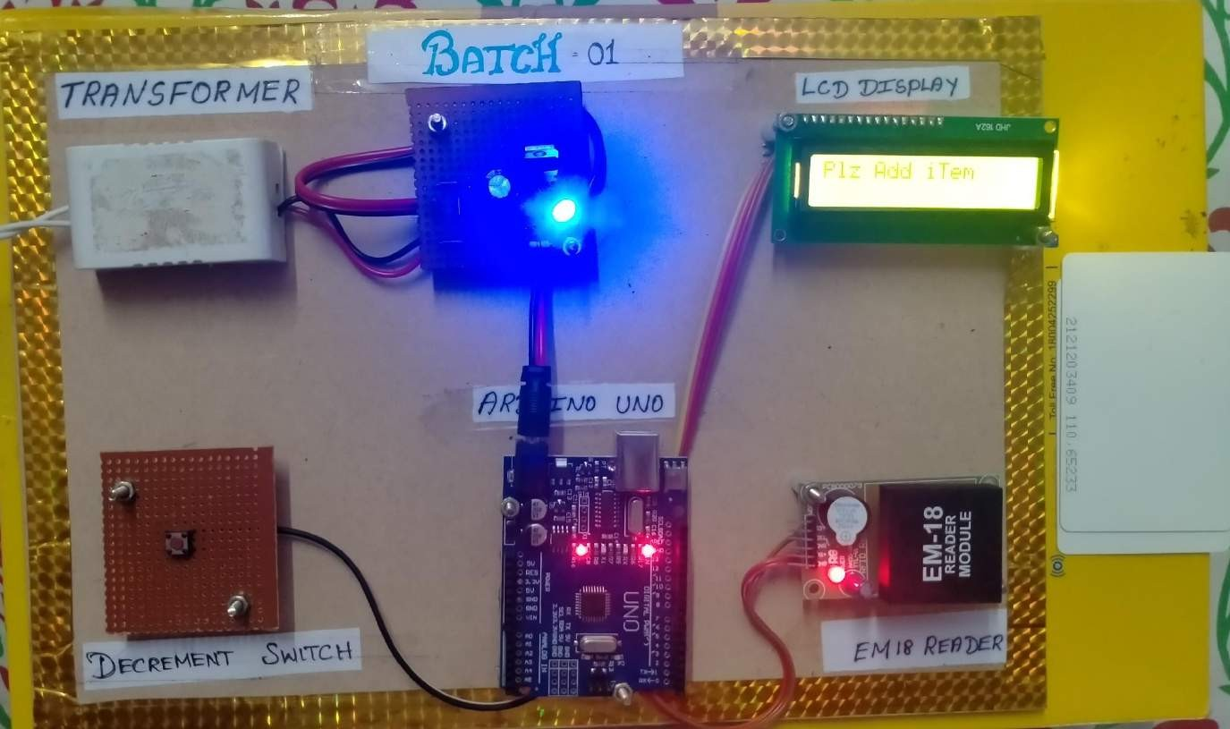
Hardware Setup cont..,

Slide 21
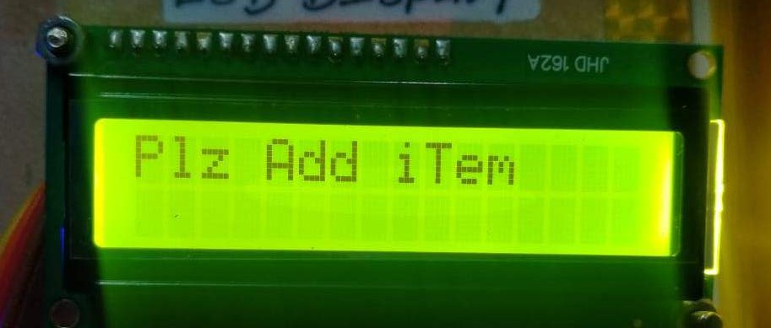
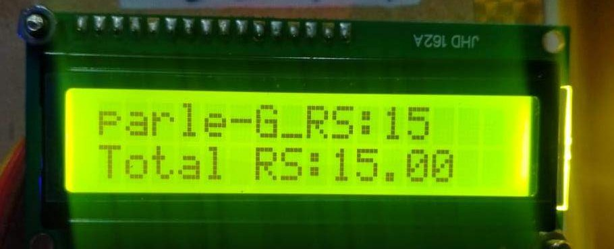
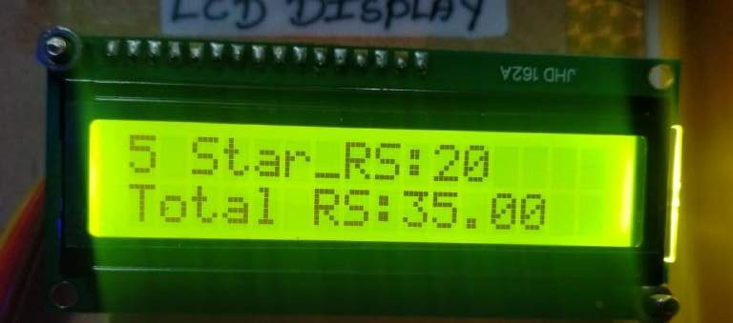
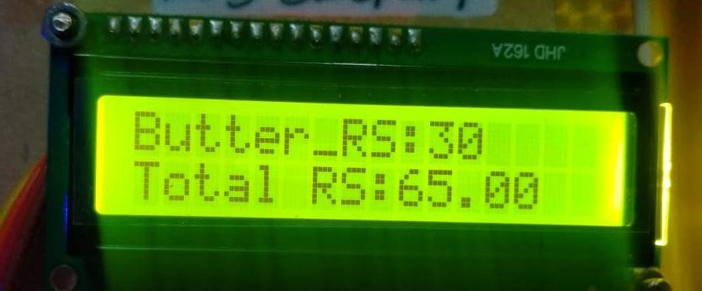
Result and Discussions

Slide 22
Result and Discussions cont..,
The figures shown in before slides represents the output of our project;
The first image shows the “plz add item”, it will be displayed until we add any items or products in the cart.
Once we started to scan our products, it will display the product name, its price and the total price.
From image 2,3 and 4, we can infer that Parle-G, 5 star and Butter are scanned respectively, then their prices are added. Finally it displays the total price to be paid.

Slide 23
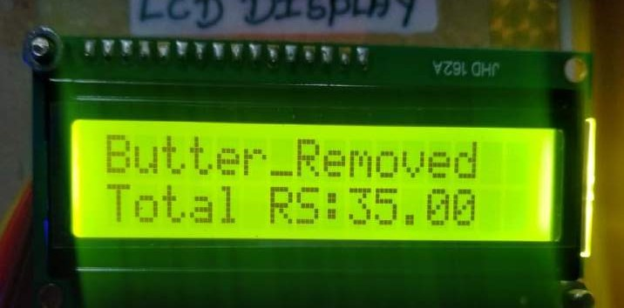
Result and Discussions cont..,
Decrement process:
When we want to remove the product which was mistakenly taken by the consumer, press the decrement push button and scan the mistaken product simultaneously, then the product’s price will be decremented in the total price.

Slide 24



Hardware Setup and the kit Working process video

Slide 25
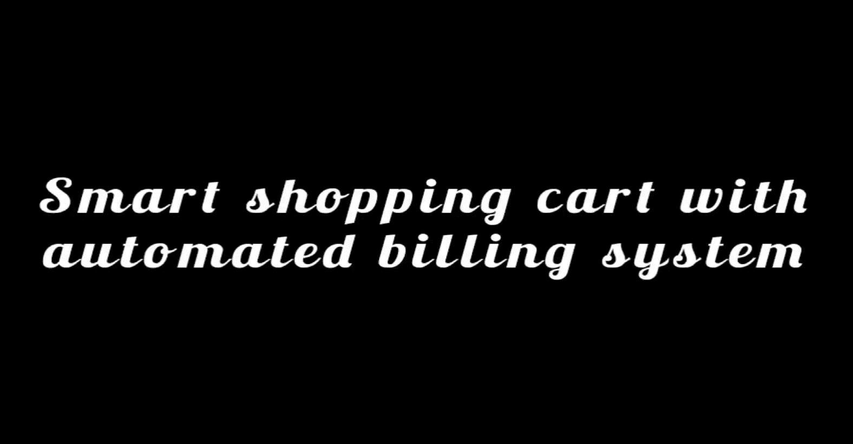

Slide 26

Conclusion
The progression in science & technology development is an unstoppable process. Now & then evolution changing technologies are being invented.
This innovative project idea can be used in places like shopping complexes,
supermarkets & malls to purchase the products.
Hence this project will help in improving the security & also the shopping time can be reduced.
It also provides an enjoyable & user- friendly shopping experience to the
customers.

Slide 27

Future Scope
Development of this project can be done in many ways, where RFID tags can be replaced by RFID stickers which are small in size and low cost.
Security can be improved by counting the number of items or placing weight sensors within the cart for tallying the weight and getting all the types of product names when cart is passed through a particular aisle using camera module.
Multiple RFID tags can be read using a single RFID reader for more number of products which are added in the cart.

Slide 28

Reference
https://how2electronics.com/smart-shopping-cart-with-automatic-billing-system- using-rfid-arduino/
https://ijrti.org/papers/IJRTI1904010.pdf
https://www.youtube.com/watch?v=q7dgn4fesR8&ab_channel=svsembedded
https://www.ijert.org/smart-shopping-cart-with-automated-billing-system

Slide 29
List of Publications
Mr M.RAMESH, P.ABINAYA, P.KARTHIKA, D.S.MADHUMITHA of M.
Kumarasamy College of Engineering presented the paper entitled “SMART
SHOPPING CART WITH AUTOMATED BILLING SYSTEM” in the International
Conference on Recent Advancements in Engineering and Technology (ICRAET'23) held at M.KUMARASAMY COLLEGE OF ENGINEERING, Karur, Tamil Nadu, India during 31st March 2023.

Slide 30

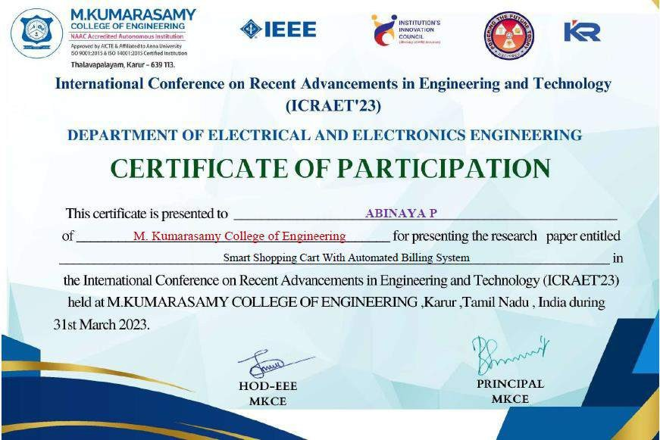
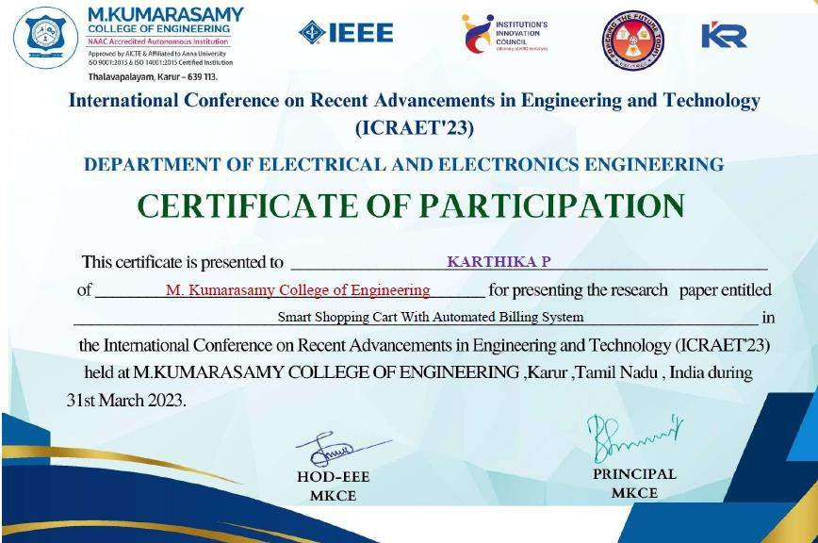


Slide 31
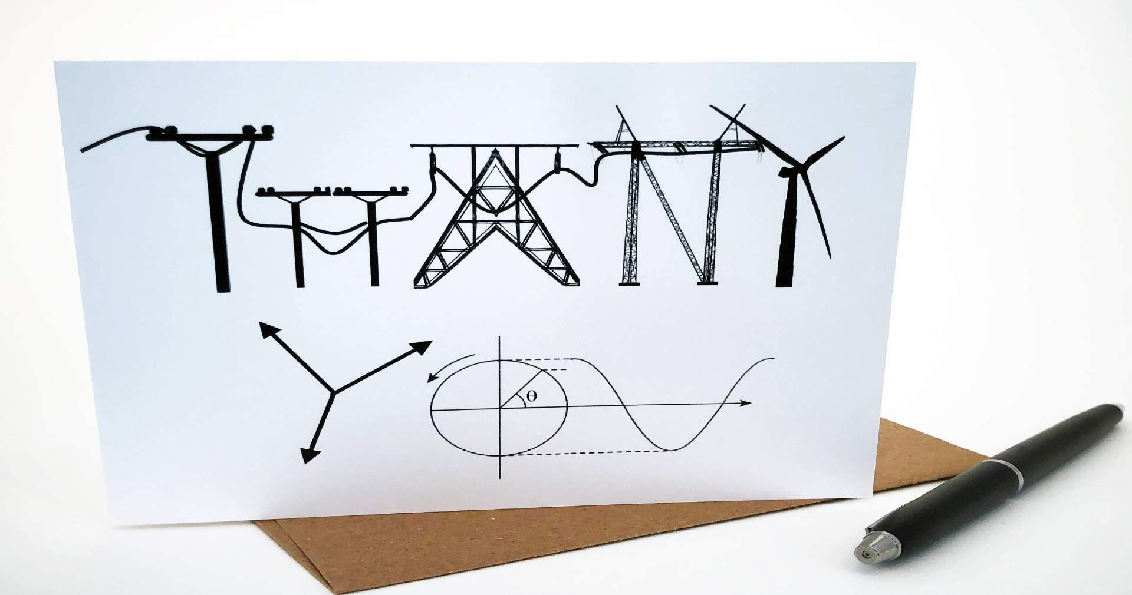
31

